Slide 1
Applied Deep Learning
Module 10:
Chapter 13
Chapter 14
Notes:
These are notes for the slide

Slide 2
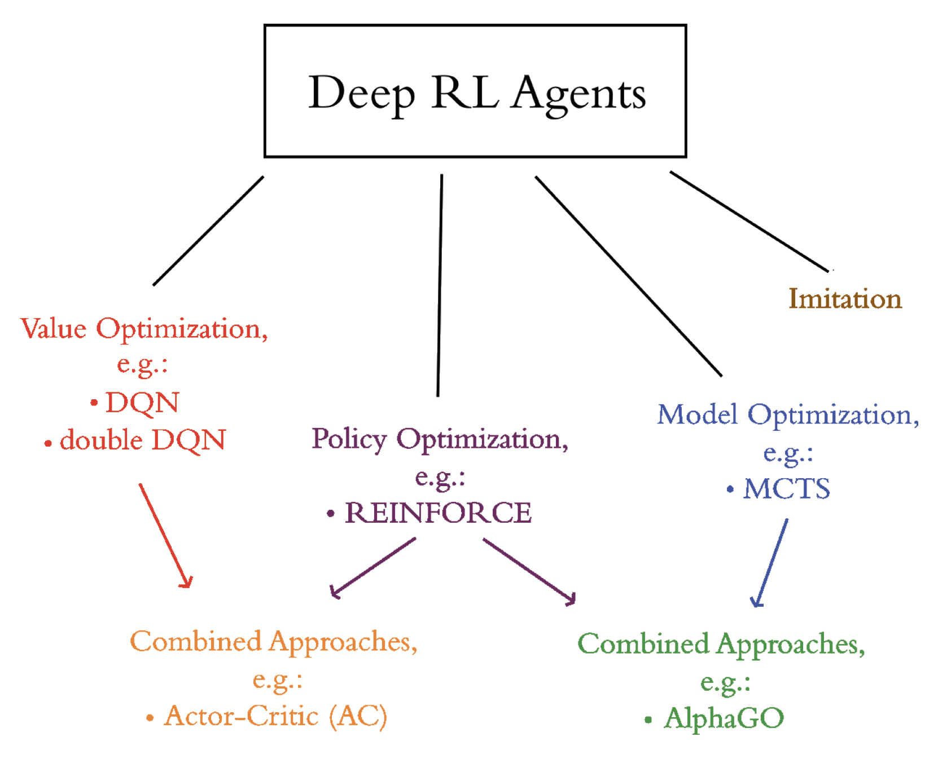
Chapter 13
Deep Reinforcement Learning

Slide 3
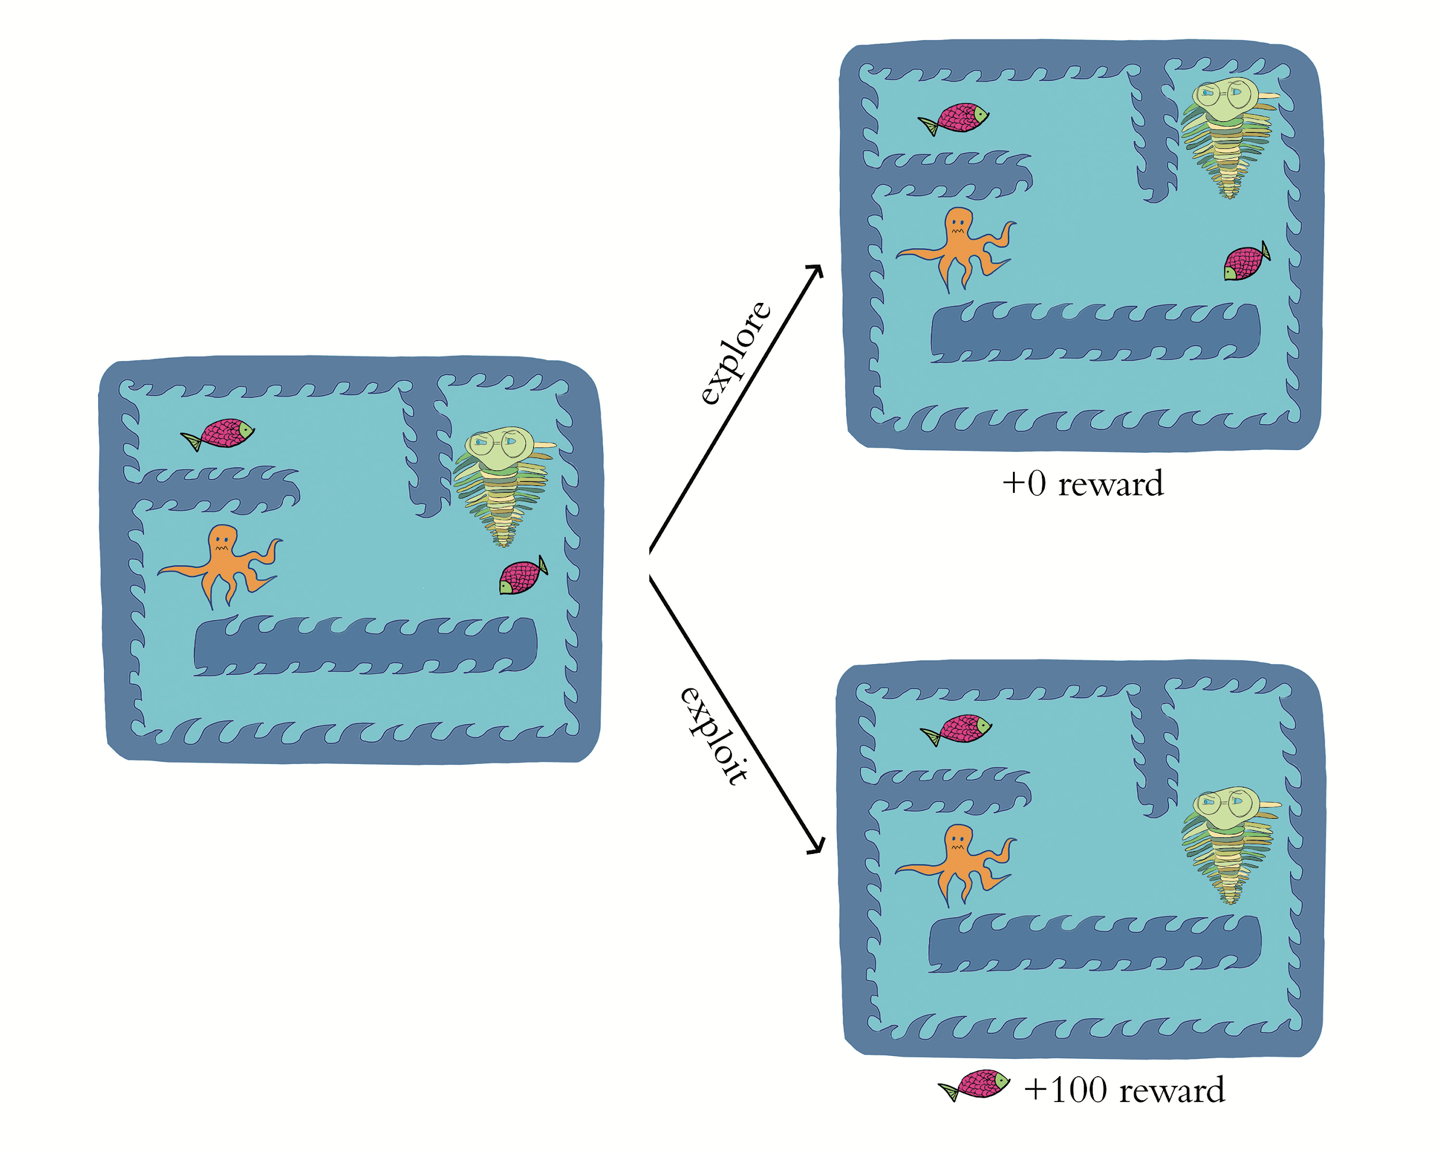
Exploration Rate epsilon

Slide 4
SLM Lab Features
Ready-Made Deep RL Agents
Modular Agent Components
Various Environment Libraries
Multiple Environment Libraries Simultaneously
Performance Benchmarking
Hyperparameter Tuning

Slide 5
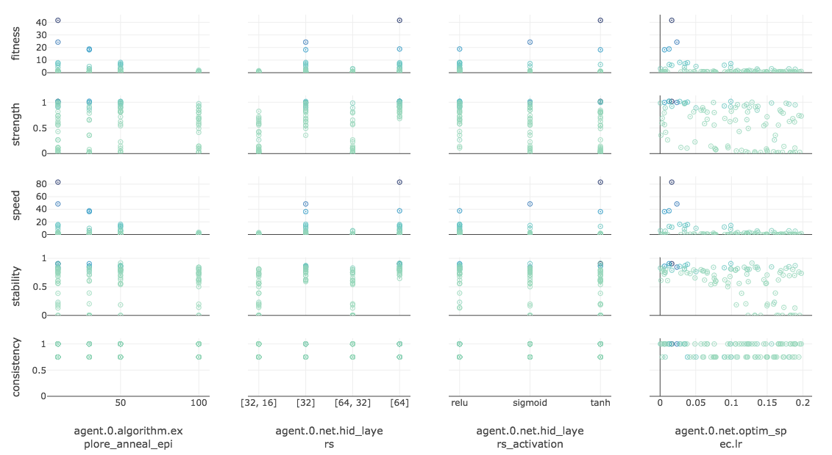

Slide 7
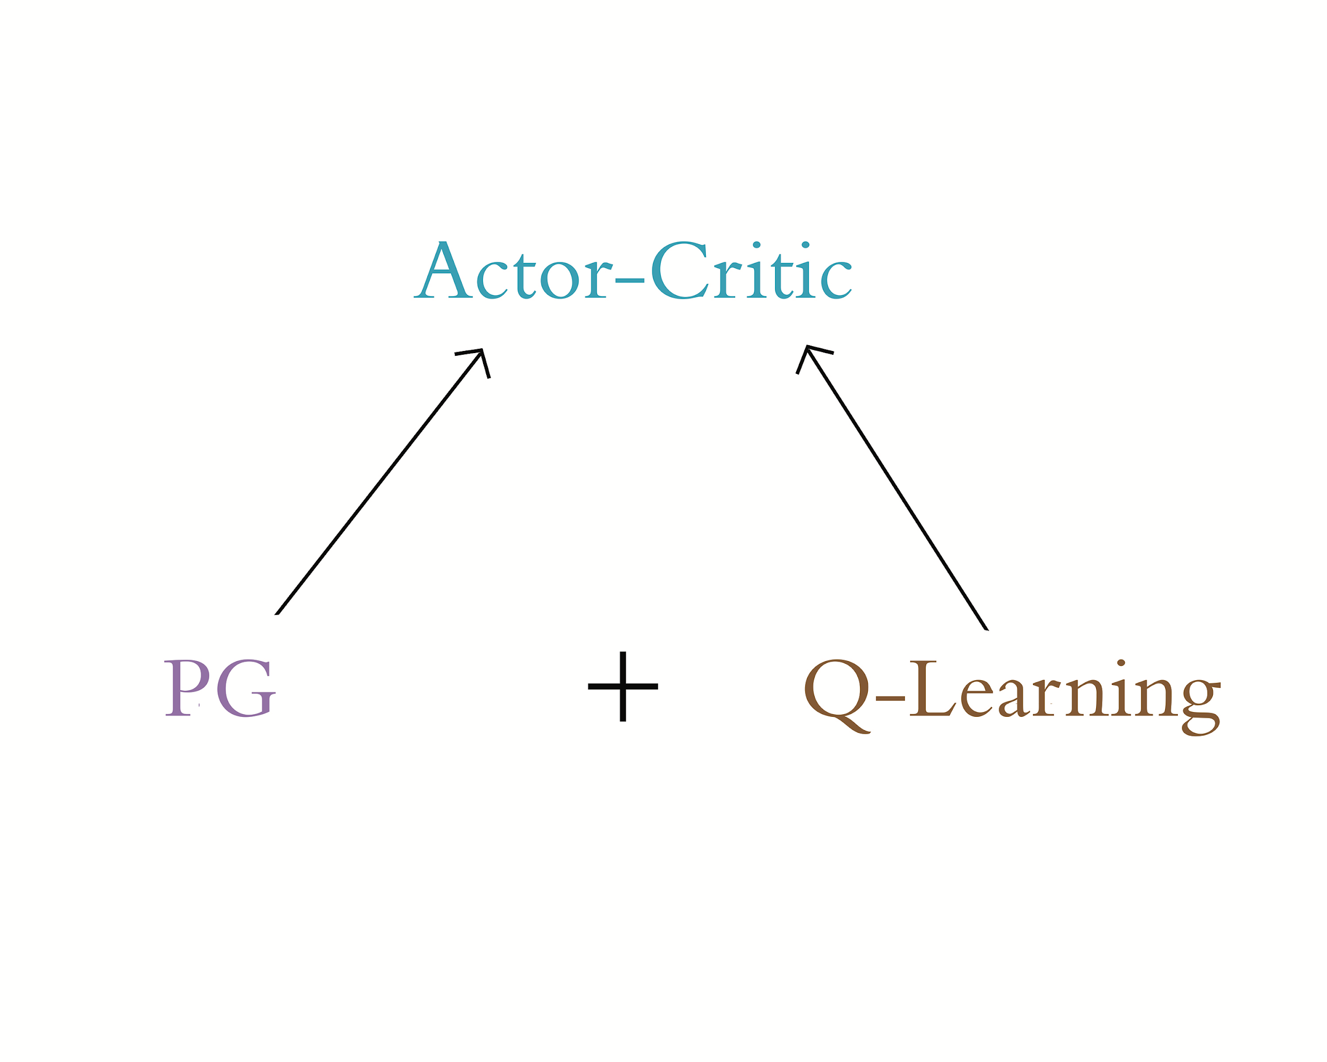

Slide 8
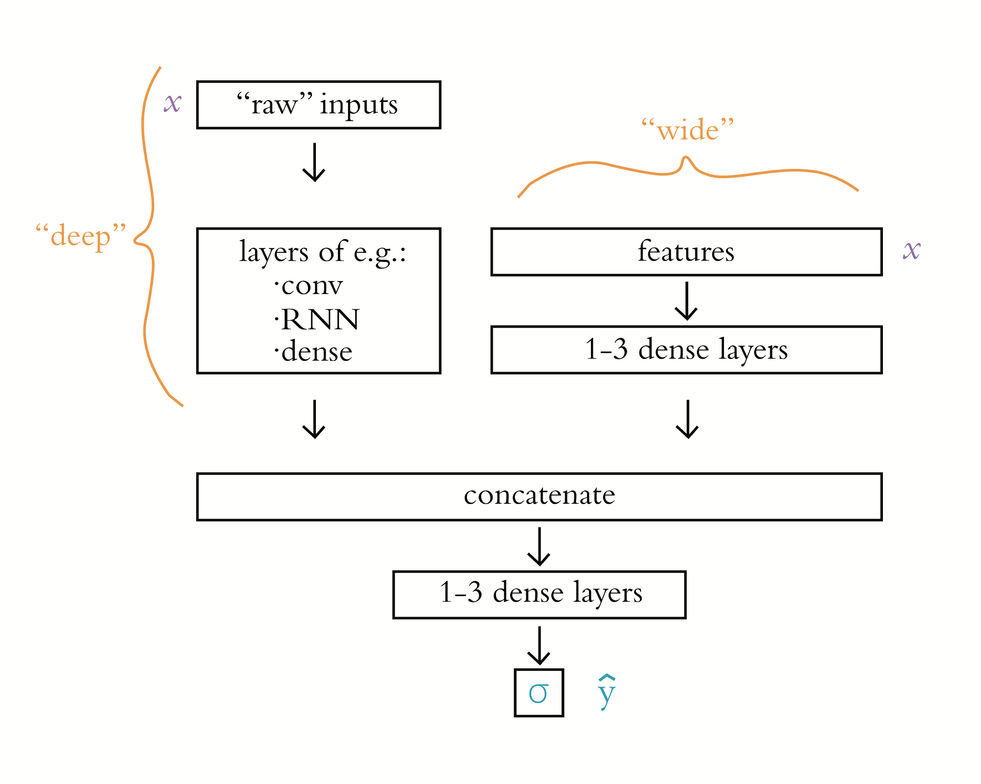
Chapter 14
Your Own Deep Learning Projects

Slide 9
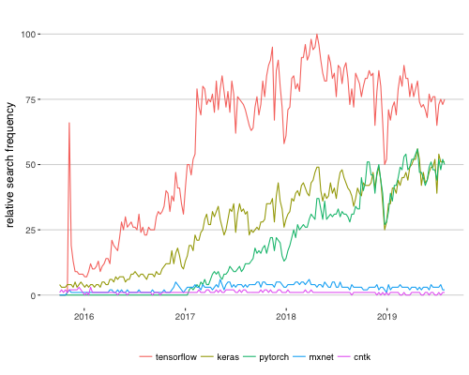
Deep Learning Library Popularity

Slide 10
TensorFlow 2.0
use layers (Keras) by default
autodiff Eager execution by default
JIT compiler for optimization, especially across devices
subclassing for unlimited flexibility, e.g.:
custom loss, optimizers, layers, training loops
repeating layers, blocks of layers
data pipelines and processing, e.g., tf.data, tf.io
portability:
TensorFlow Serving: high-performance systems across servers
TensorFlow Lite: for mobile or embedded devices
TensorFlow.js: for web browsers
to update code from 1.x: tensorflow.org/alpha/guide/migration_guide

Slide 11
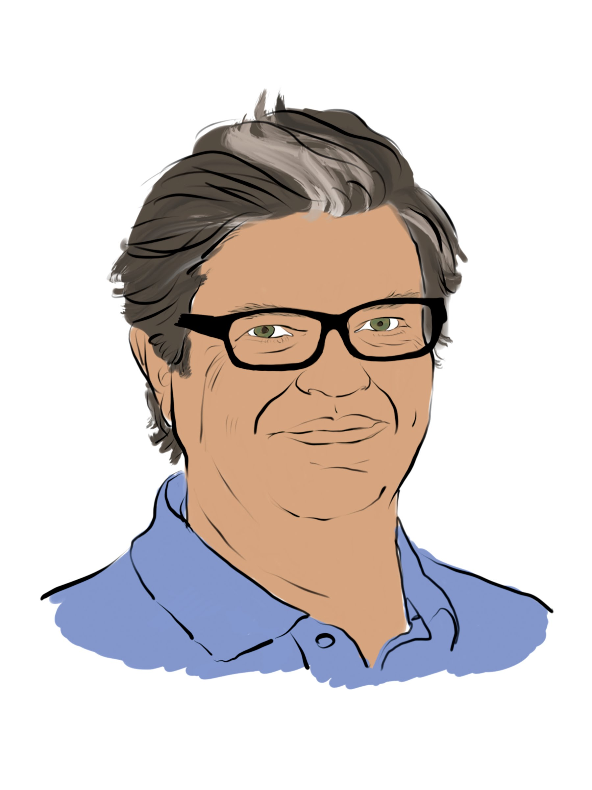
Yann LeCun

Slide 12
Deep Learning Library Popularity

Slide 13
PyTorch | TensorFlow
“NumPy”, optimized for GPUs | ported to Python from C++
dynamic auto-differentiation (autodiff) | static computational graph (prior to 2.0)
debugging is easier
fast.ai API | Keras API
 | more widely adopted
TorchScript Just-In-Time compilation | TensorFlow Serving, .js, Lite, tf.data, tf.io
better for interactively building models | better for production deployments

Slide 14
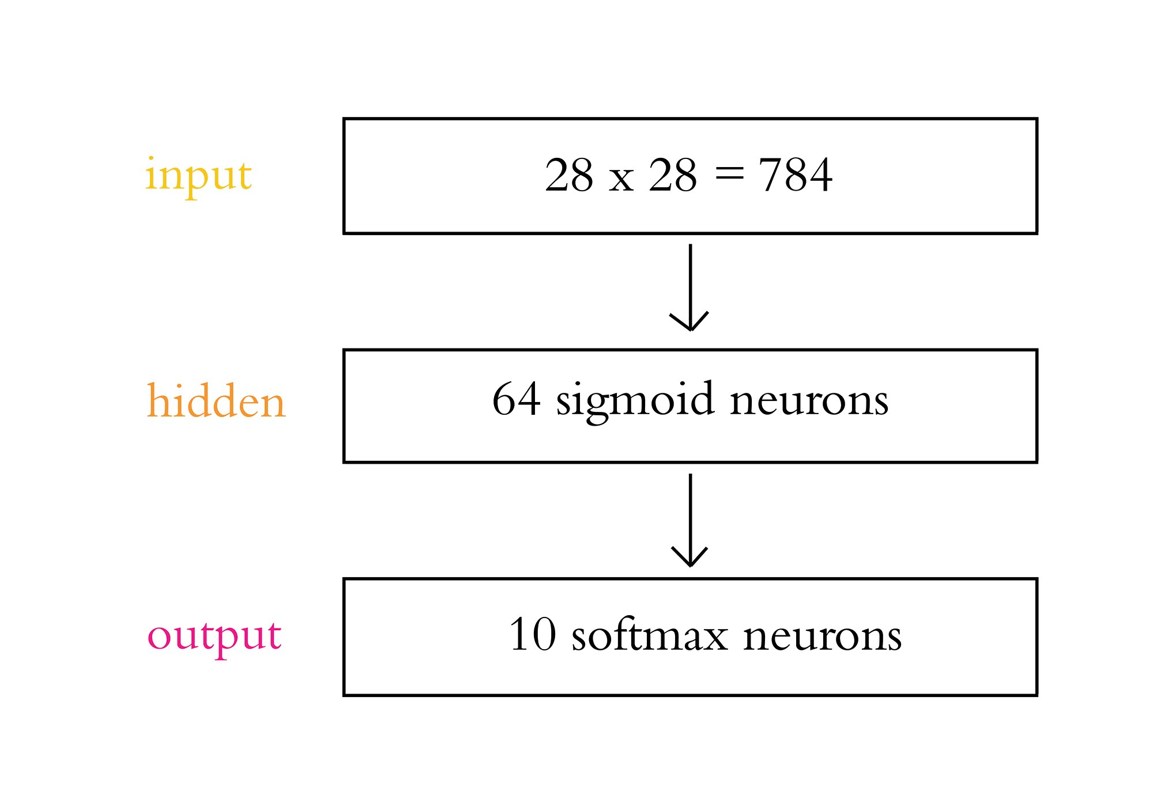

Slide 15
Hyperparameter Tuning
Parameter initialization
Cost function selection
Get above chance
Layers
Avoid overfitting
Learning rate
Batch size

Slide 16
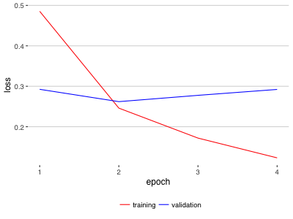
Overfitting

Slide 17
Automated Hyperparameter Search
Spearmint: github.com/JasperSnoek/spearmint
Hyperopt
Hyperas
kopt
talos

Slide 18
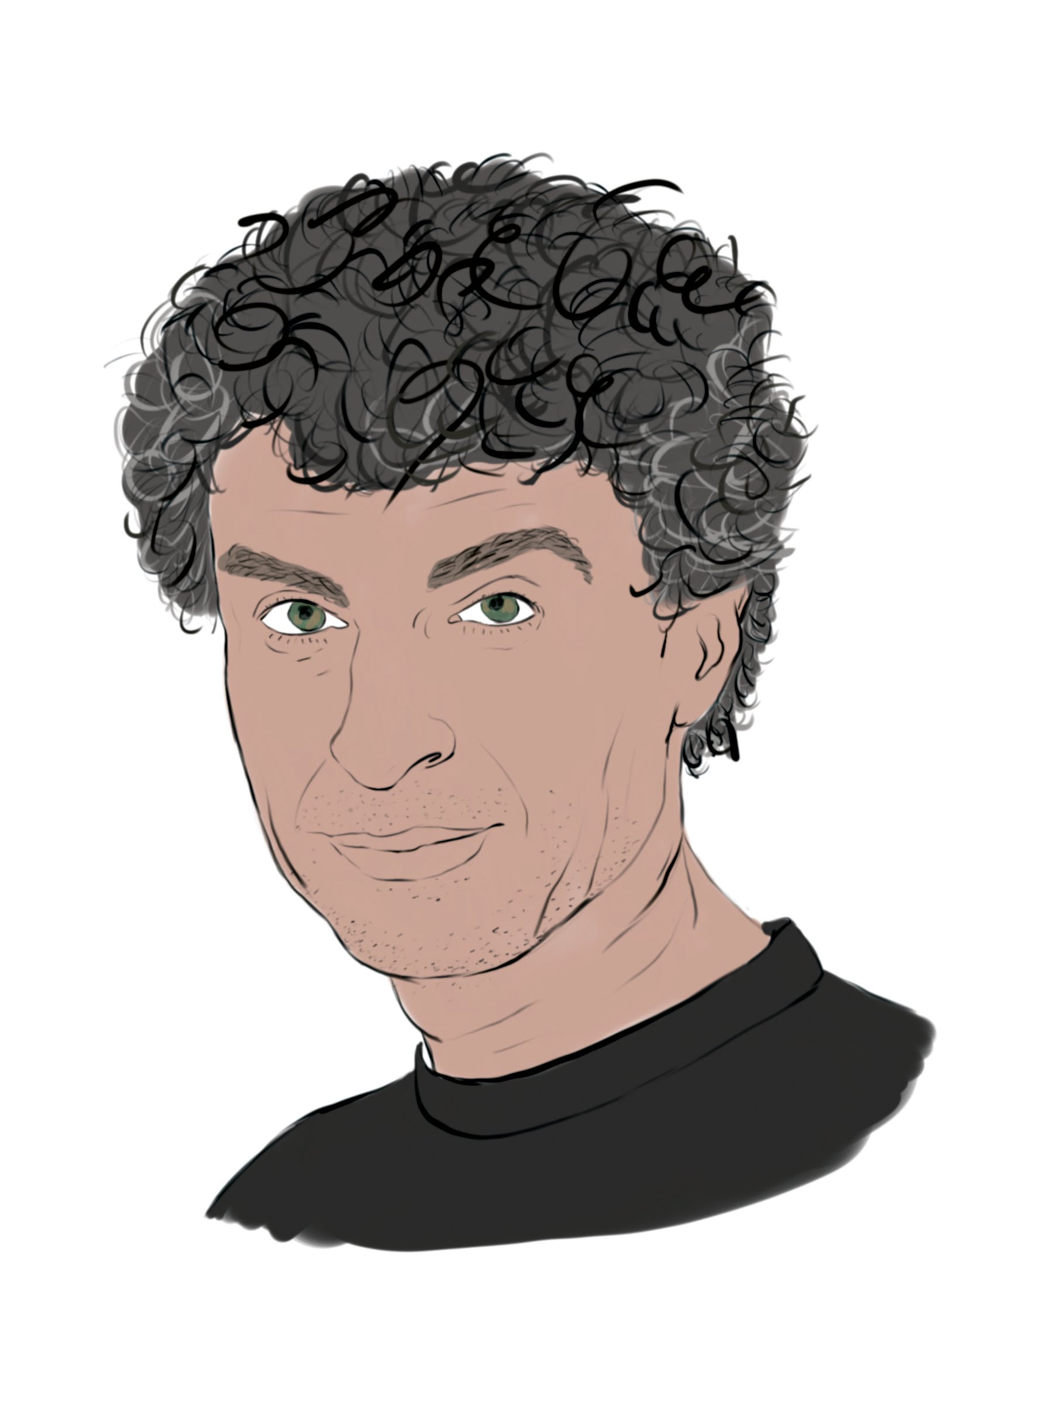
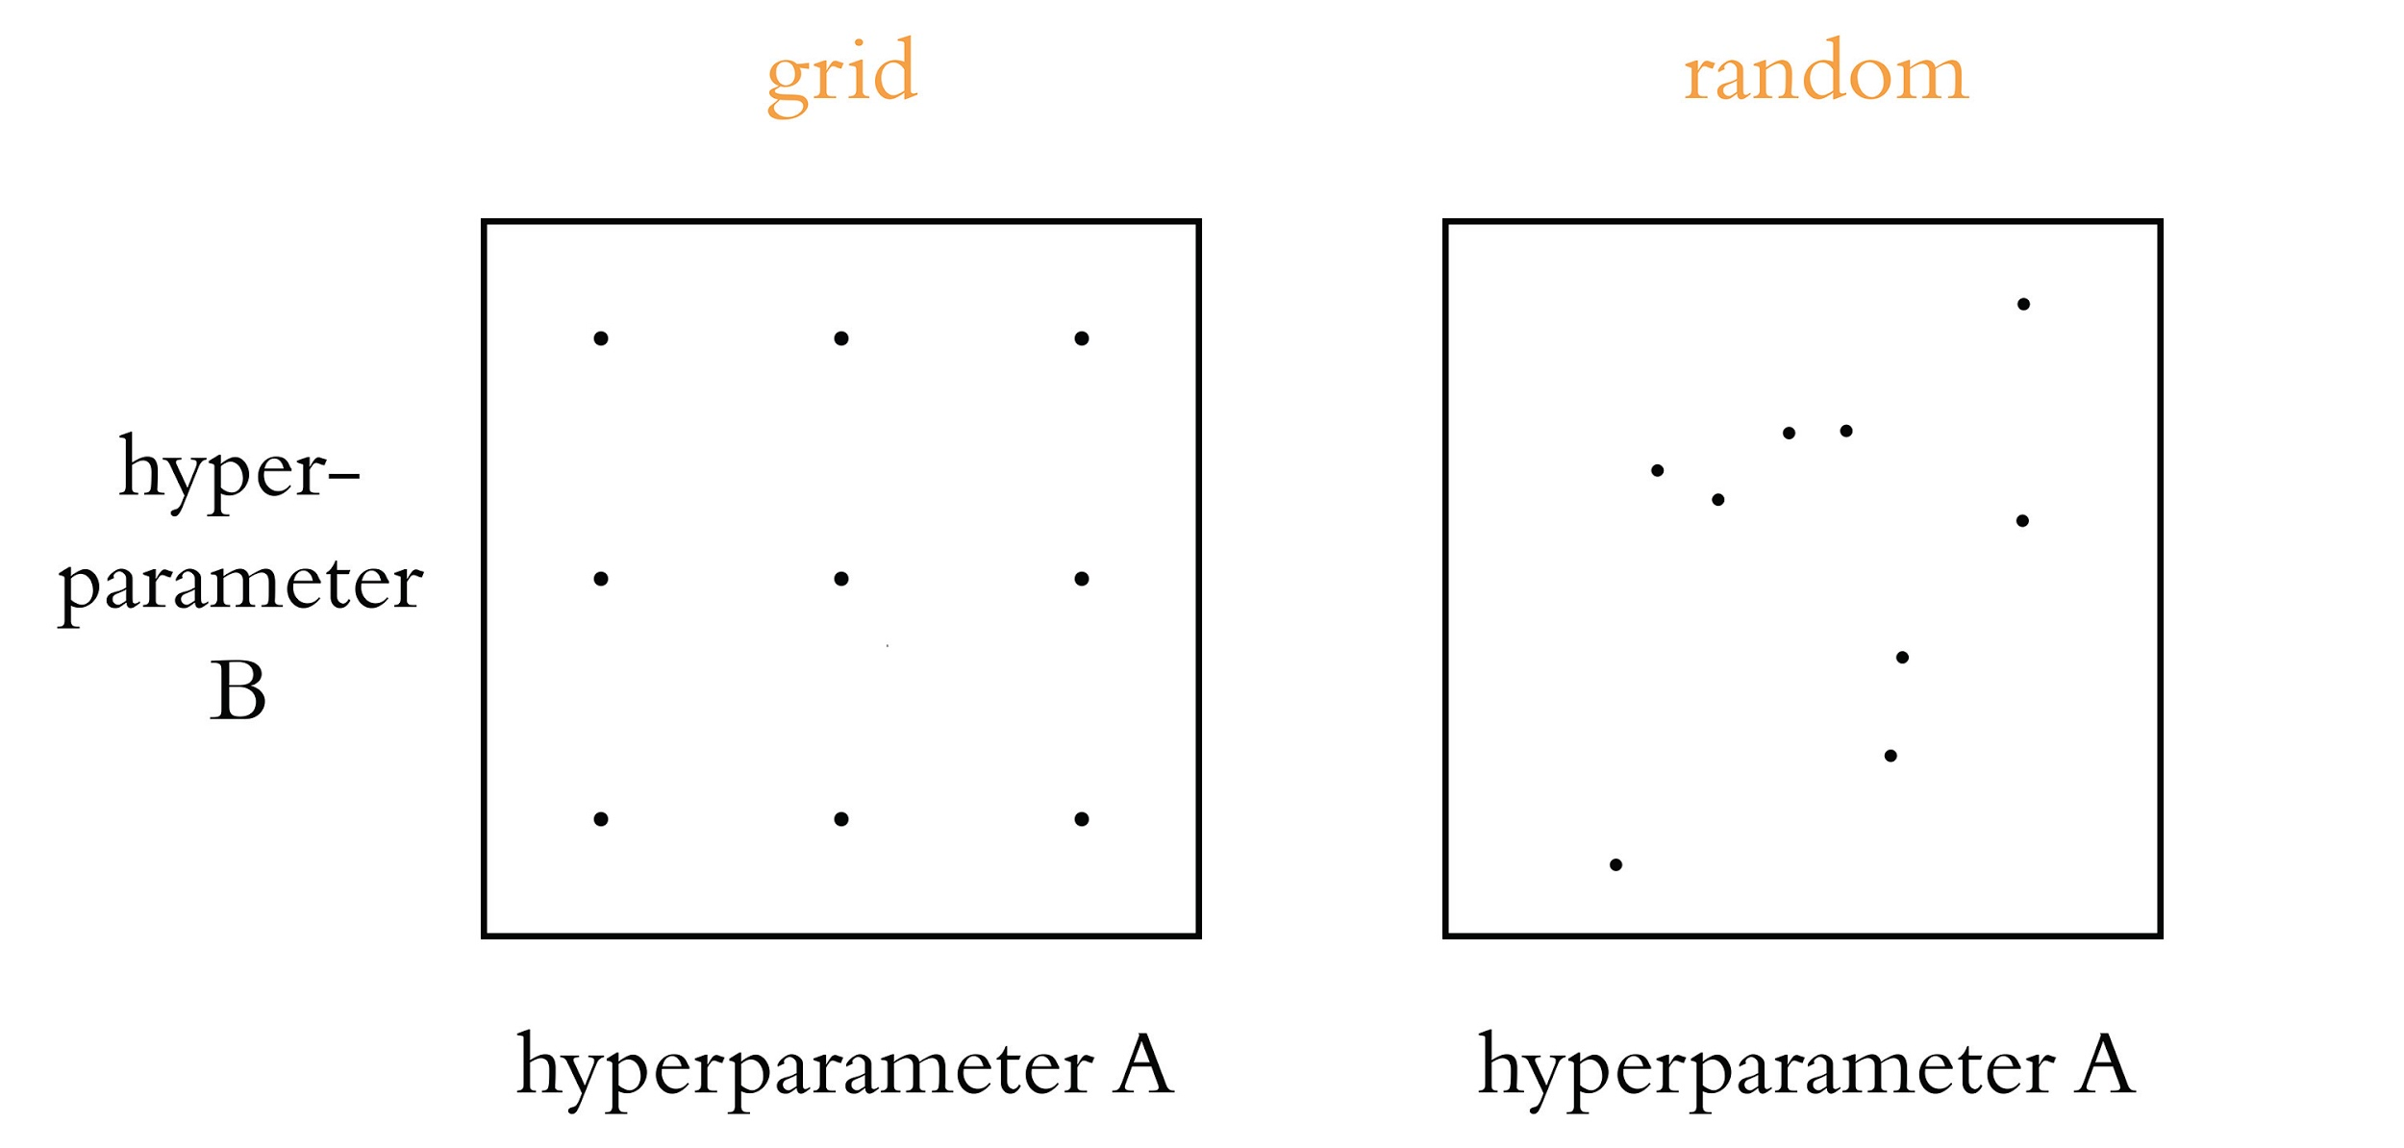

Slide 19
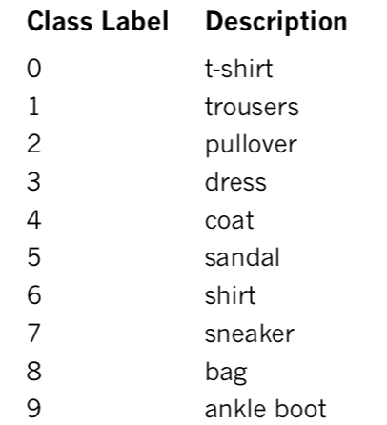
Fashion MNIST

Slide 20
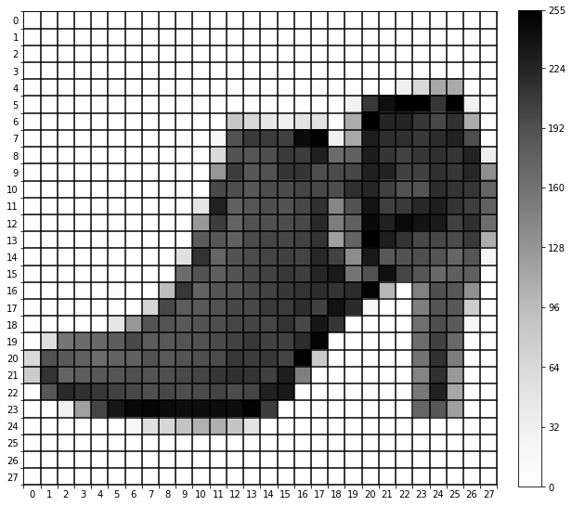
Fashion MNIST

Slide 21
Machine Vision Datasets
Kaggle: kaggle.com
Figure Eight: figure-eight.com/data-for-everyone
Luke de Oliveira: bit.ly/LukeData

Slide 22
“Wide and Deep” Models

Slide 23
Social-Impact Domains
1. Equality and inclusion
2. Education
3. Health and hunger
4. Security and justice
5. Information verification and validation
6. Crisis response
7. Economic empowerment
8. Public and social sector
9. The environment
10. Infrastructure

Slide 24
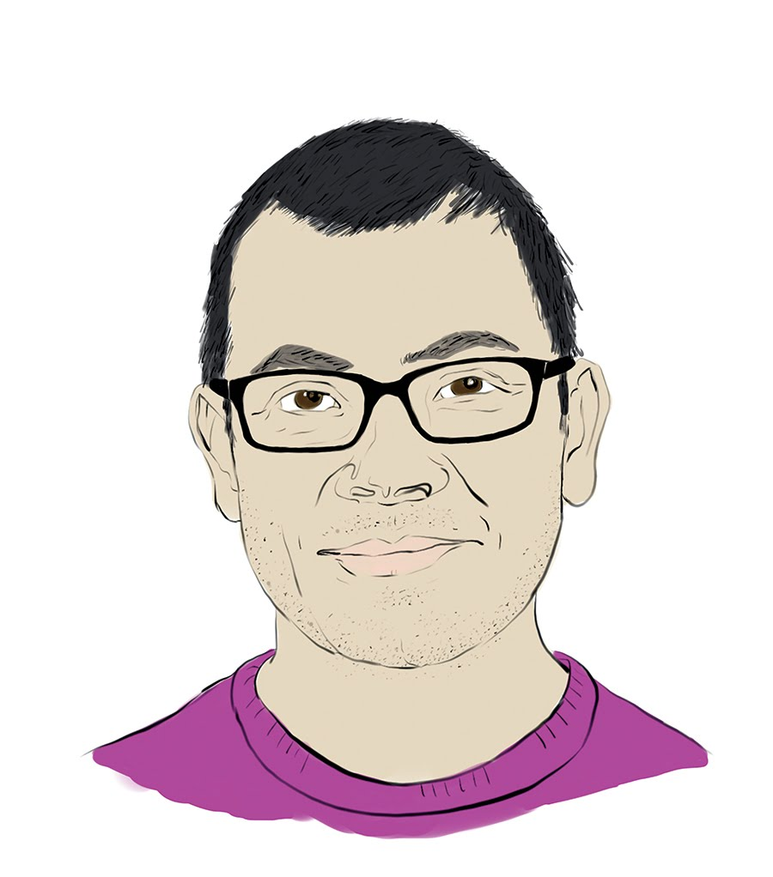
Demis Hassabis and Yoshua Bengio

Slide 25
Climate Change Solution Domains
Electricity systems
Transportation
Buildings and cities
Industry
Farms and forests
CO₂ removal
Climate prediction
Societal impacts
Solar geoengineering
Tools for individuals
Tools for society
Education
Finance

